Slide 1
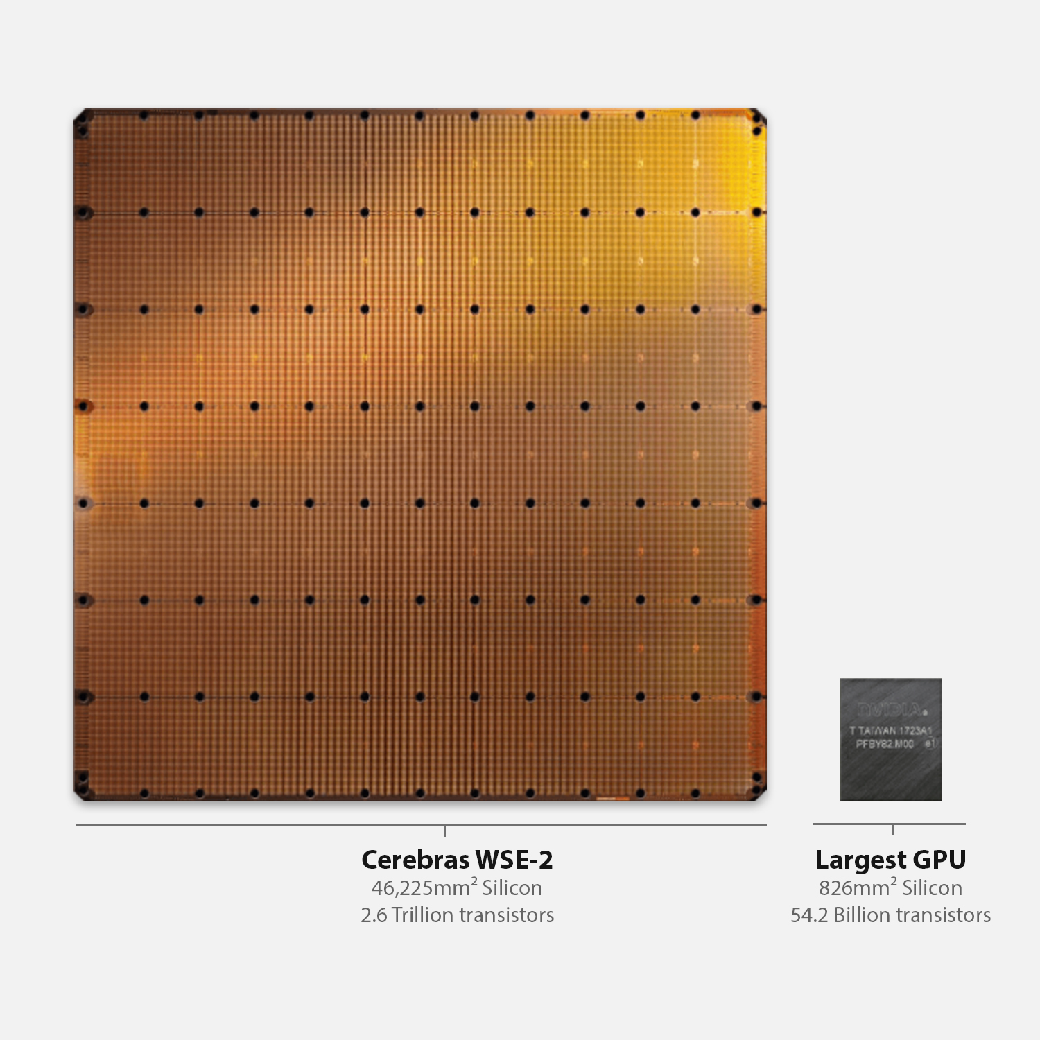



Cerebras SDK walk-through

Slide 2
Let’s get to programming the machine….
Step one – using the visitor account assigned to you, login to our CS-2 host machine
ssh vistor01@sdf-cs1.epcc.ed.ac.uk
We are now logged into the host machine that connects to the CS-2
Step two – cd into the cs2-sdk-training/practicals/walk-through which we will be working in for this part of the tutorial
[vistor01@sdf-cs1 ~]$ cd cs2-sdk-training/practicals/walk-through
[vistor01@sdf-cs1 walk-through]$ ls
wt1-getting-started wt2-basic-syntax wt3-memcpy wt4-memoryDSDs
wt5-multiple-PEs wt6-routes-fabricDSDs wt7-optimisation wt8-debugging
Let one of the tutors know if you are struggling with this

Slide 3
Running my first CSL program
Change into the wt1-getting-started directory
Compile the code using the cslc command
[vistor01@sdf-cs1 walk-through]$ cd wt1-getting-started
[vistor01@sdf-cs1 wt1-getting-started]$ cslc layout.csl --fabric-dims=8,3 --fabric-offsets=4,1 --memcpy --channels=1 -o out
INFO: Using SIF: /home/y26/shared/cs_sdk-1.0.0/cbcore_sdk-202311111408-10-4a54bce5.sif
compile successful
[nebcs1@sdf-cs1 wt1-getting-started]$ ls out/
bin east out.json west
[nebcs1@sdf-cs1 wt1-getting-started]$ ls out/bin/
out_0_0.elf out_rpc.json
Run (via the simulator)
[vistor01@sdf-cs1 walk-through]$ cs_python run.py --name out
INFO: Using SIF: /home/y26/shared/cs_sdk-1.0.0/cbcore_sdk-202311111408-10-4a54bce5.sif
Congratulations! You have run your first CSL program (although it doesn’t do very much yet!)

Slide 4
What are these arguments to the CSL compiler?
[vistor01@sdf-cs1 wt1-getting-started]$ cslc layout.csl --fabric-dims=8,3 --fabric-offsets=4,1 --memcpy --channels=1 -o out
--fabric-dims=8,3 defines the size of the simulated fabric, which is 8 x 3
--fabric-offsets=4,1 defines where the program is placed on the fabric.
--memcpy this flag is required to enable memcpy within the host program (we discussed this in the architecture slides)
--channels=1 determines the number of ethernet links that can be used to transfer data to/from the CS-2 (maximum of 12)
-o out is the directory where the executables will be saved

Slide 5
What’s this layout.csl?
Defines the layout of the program on the CS-2
[vistor01@sdf-cs1 wt1-getting-started]$ cslc layout.csl --fabric-dims=8,3 --fabric-offsets=4,1 --memcpy --channels=1 -o out
const LAUNCH: color = @get_color(8);
const memcpy = @import_module("<memcpy/get_params>", .{
.width = 1,
.height = 1,
.LAUNCH = LAUNCH
});
layout {
@set_rectangle(1, 1);
@set_tile_code(0, 0, "pe_program.csl", .{ .memcpy_params = memcpy.get_params(0) });
@export_name("init_and_compute", fn()void);
}
Colour (virtual channel) used for Remote Procedure Call (RPC) mechanism
Imports the memcpy module (WSE side of memcpy support) needed to launch kernel
We are using just one PE (columns=1, rows=1)
The lone PE should execute “pe_program.csl” and we pass the memcpy parameters as a parameter
Expose this function “init_and_compute” to the host
In the layout.csl file you will see comments to explain these lines (omitted here for space)

Slide 6
Driving from the host
import argparse
from cerebras.sdk.runtime.sdkruntimepybind import SdkRuntime
# Read arguments
parser = argparse.ArgumentParser()
parser.add_argument('--name', help="the test compile output dir")
parser.add_argument('--cmaddr', help="IP:port for CS system")
args = parser.parse_args()
# Construct a runner using SdkRuntime
runner = SdkRuntime(args.name, cmaddr=args.cmaddr)
# Load and run the program
runner.load()
runner.run()
# Launch the init_and_compute function on device
runner.launch('init_and_compute', nonblock=False)
# Stop the program
runner.stop()
We create an instance of the Cerebras SdkRuntime (the host side library that interacts with the CS-2).
Load our compiled program onto the WSE
Start running the program on the WSE. This won’t do anything yet, it activates and is ready for a Remote Procedure Call (RPC) from the host.
Launch the “init_and_compute” function on the WSE and wait until it has completed
Stop the program on the WSE and clean up

Slide 7
Exploring the pe_program.csl code
// Struct containing parameters for memcpy layout
param memcpy_params: comptime_struct;
const sys_mod = @import_module("<memcpy/memcpy>", memcpy_params);
// Constants defining dimensions of our data
const N: i16 = 3;
// 48 kB of local PE memory contains x and y
var x: [N] f32;
var y: [N] f32;
fn sum(x_ptr : *[N] i16, y_ptr : *[N], value : i16) void
{
…
}
fn initialize() void {
…
}
fn init_and_compute() void {
…
}
comptime {
// Export function so it is host-callable by RPC mechanism
@export_symbol(init_and_compute);
// Create RPC server using color LAUNCH
@rpc(@get_data_task_id(sys_mod.LAUNCH));
}
Infrastructure we need for the memcpy library support
Defines a constant integer of 16 bits
Declares arrays x and y to be of size N and type single-precision floating point. These are allocated in the PE’s local memory
We will look at these functions in detail in a minute
Sets up the program by exporting the “init_and_compute” function
Create an RPC server (so it can be called from the host) using the colour defined in layout.csl

Slide 8
Exploring the pe_program.csl code
Defines sum to be a function with a void return type. It accepts three arguments
The value argument is a scalar of type i16 (16-bit integer). CSL uses a colon to provide type information
fn sum(x_ptr : *[N] i16, y_ptr : *[N], value : i16) void
{
for (@range(i16, N)) |idx| {
y_ptr.*[idx] += value * x_ptr.*[idx];
}
}
x_ptr and y_ptr are defined as pointers of over memory of size N. Like C, the asterisk, *, represents a pointer
This is a for loop, which loops over some array and at each iteration the variable idx contains the loop’s current value
This is very similar to a loop in Python but just with a different syntax.
The in-built range function is used here to provide an array containing 0 to N-1 with each element of type i16. Again this is similar to Python’s range function
The asterisk is used to dereference a pointer, so here we are accessing the idx element of y_ptr

Slide 9
Exploring the pe_program.csl code
This initialise function accepts no arguments and returns no value
fn initialize() void {
for (@range(i16, N)) |idx| {
x[idx] = 1.0;
y[idx] = @as(f32, idx);
}
}
fn init_and_compute() void {
initialize();
sum(&x, &y, 2);
// After this function finishes, memcpy's cmd_stream must
// be unblocked on all PEs for further memcpy commands
// to execute
sys_mod.unblock_cmd_stream();
}
For loop, looping up to N with the idx variable containing the loop value at each iteration
Accesses the global variables x and y, setting x to be the value 1.0 and y to be the current loop value (cast to a 32-bit floating point)
Entry point called by the host
Calls the initialise function followed by sum , with x and y global variables as arguments and the scalar value 2
After the work completes need to do some cleanup on the command stream to ensure can execute further commands

